Slide 1
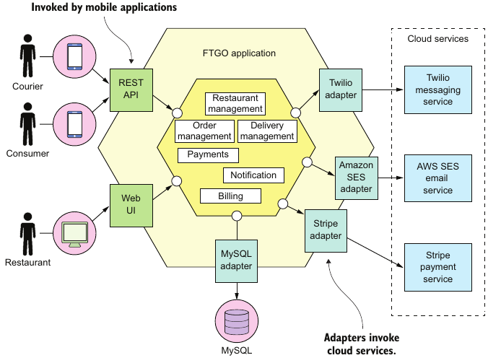
Monolithic Architecture
Monolithic : Widely-used, structured a system as a single execution or deployable component
Practically not bad in most general case
Under this case, the software devs suffered monolithic hell when the system grows
Benefits:
- Simple to deploy
- Easy on making radical changes to the app
- Straightforward to test (end-to-end)
-Straightforward to deploy (single system file)
- Easy to scale (multiple instance of the program)

Slide 2
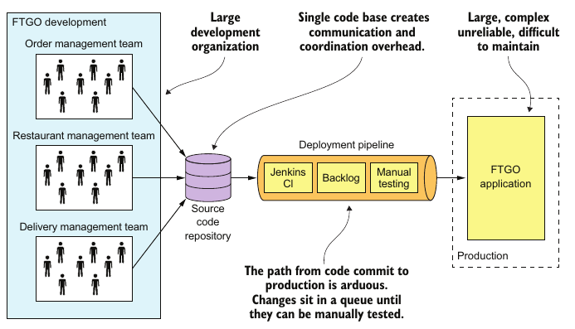
Monolithic HELL
Once the program evolve to large level, the suffering started
- Code base
- Management cost
The hell is:
- Complexity intimidates developers
- Devs is slow (time-consuming update)
- Path from commit to deployment is long and arduous (2011, Amazon deployed every 11.6 secs)
-> impossible for CD
- Scaling is difficult (both dimensions)
- Delivering a reliable monolithic is challenging (large test, bugs, fault isolation)
- Locked into increasingly obsolete technology stack (conflicting old libs)

Slide 3
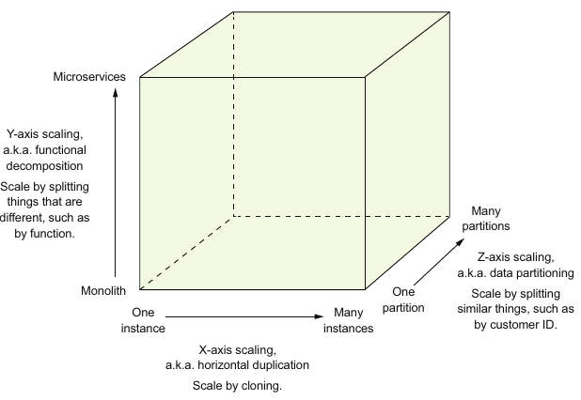
Microservices
- Functional requirement is mostly irrelevant to software architecture
-> big ball of muds
- Architecture matters
-> giant drawback
- Must migrate to new architecture:
Microservices (the name is confusing)
- Adrian Cockcroft (Netflix) :
A service-oriented architecture composed of loosely coupled elements that have bounded contexts.

Slide 4
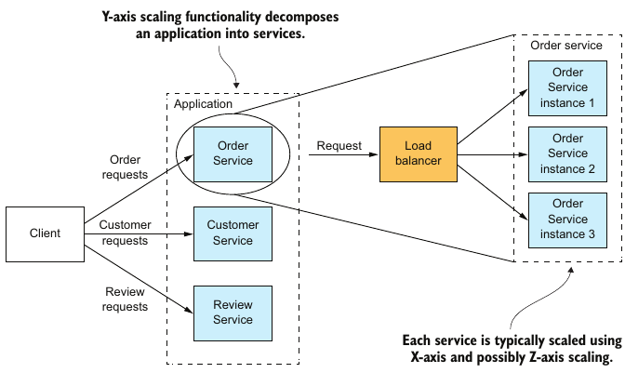
Y-Axis Scaling functionalities
A service is a mini application that implements narrowly focused functionality
The high-level definition of microservice architecture (microservices) is an archi-
tectural style that functionally decomposes an application into a set of services.
-> Microservice architecture is a form of modularity.

Slide 5
Modularity
Modularity is essential
large, complex application must be decomposed
even though the help of the languages (java packages), this approach doesn't work in practice. Big ball of mud turns out eventually undeniable
Microservices uses services as unit of modularity
-> independently deploy, test and update.
-> preserve modularity
Each service has its own database
The services loosely coupled and communicate via APIs
Seperate datastore is the solution
Data isolation helps better performace -> less locks

Slide 6
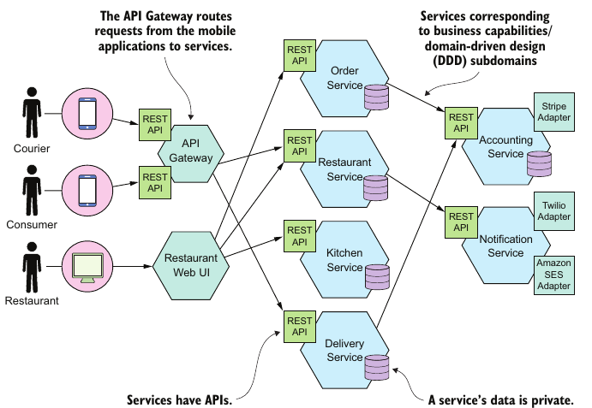
Examples

Slide 7
Benefits and Drawbacks of Microservices
Benefits
It enables the continuous delivery and deployment of large, complex applications.
Services are small and easily maintained.
Services are independently deployable.
Services are independently scalable.
The microservice architecture enables teams to be autonomous.
It allows easy experimenting and adoption of new technologies.
It has better fault isolation.
Drawbacks
Finding the right set of services is challenging. (no concrete optimal algorithm to decompose; worsely, distributed monolith could be coped w)
Distributed systems are complex, which makes development, testing, and deployment difficult.
Deploying features that span multiple services requires careful coordination.
Deciding when to adopt the microservice architecture is difficult.

Slide 8
Distributed Transaction
Definition:
- Atomic business transaction that take place whenever a state modification is performed by two or more remote systems within the boundaries or the same business transaction.
Problems (State Inconsistency):
- The HTTP request fails with a timeout before the application receives the response. The operation has been executed successfully by the remote service, although the application failed to get a response and handled the exception by rolling back the database transaction.
- The HTTP request is successful but the database transaction failed to commit, due to a timeout error or even an application crash.

Slide 9
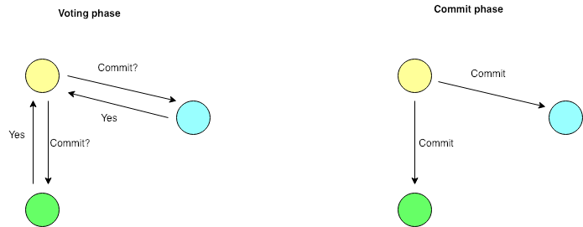
2PC
The two-phase commit protocol consists of two phases:
The commit request or voting phase.
The commit phase, where based on the voting, the system decides to commit or abort the transaction.

Slide 10
TCC
TRYING
(LOCK in SQL transaction):
The stage is mainly to test and reserve resources for the business system.
CONFIRMING
(COMMIT in SQL transactions)
Mainly to confirm the submission of the business system
CANCELING
(ROLLBACKTRYING in SQL transaction)
Examples: Bank Balance Mofication
TRYING stage: What we need to do is to reserve funds for the member fund account, that is, to freeze the amount of the member account (order amount)
CONFIRMING stage: What we need to do is to increase the points balance in the member points account, and increase the account balance in the merchant account.
CANCELING stage: If there is a problem in the confirming stage, what needs to be performed in this stage is to release the deducted member balance.

Slide 11
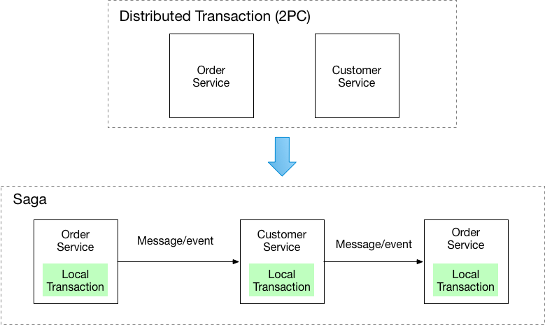
Saga
Implement each business transaction that spans multiple services as a saga.
A saga is a sequence of local transactions. Each local transaction updates the database and publishes a message or event to trigger the next local transaction in the saga. If a local transaction fails because it violates a business rule then the saga executes a series of compensating transactions that undo the changes that were made by the preceding local transactions.

Slide 12
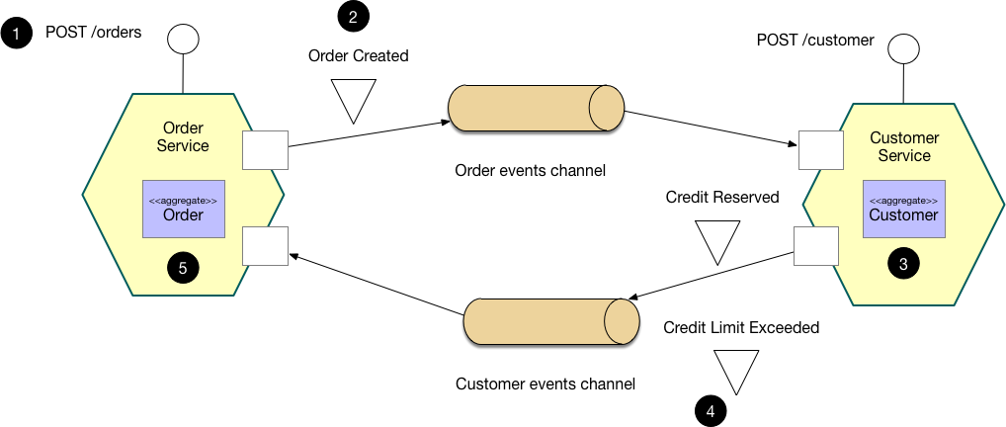
Example: Choreography-based saga

Slide 13
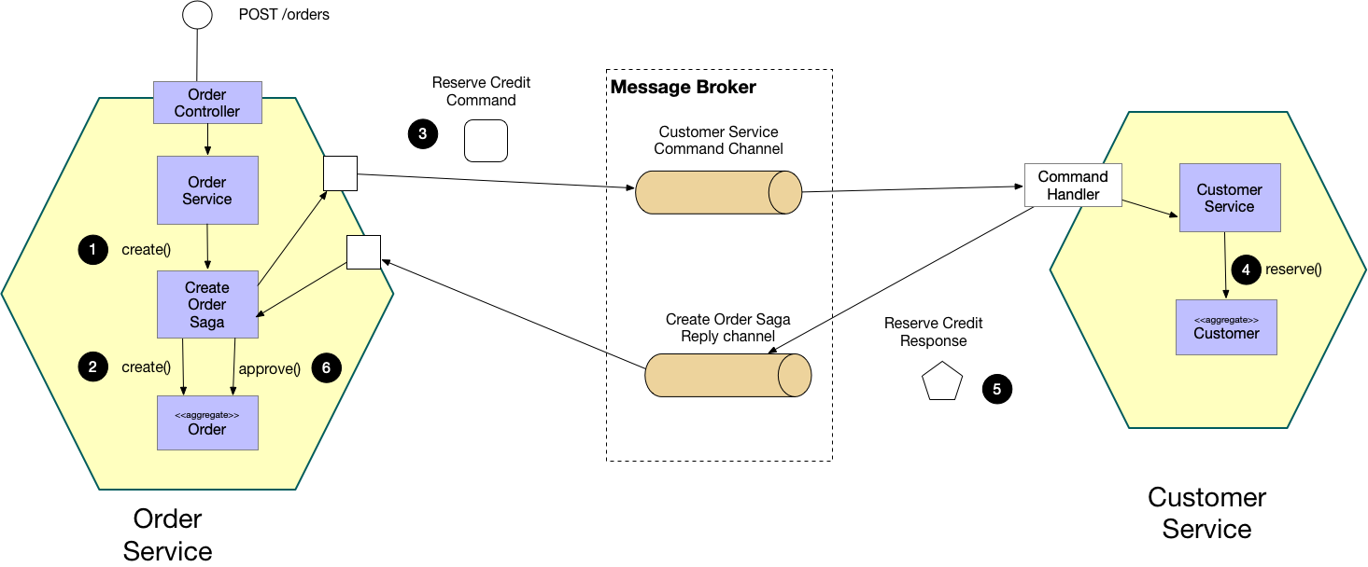
Example: Orchestration-based saga
0eh02c1nw@F

